Slide 1
Spark
Fast, Interactive, Language-Integrated Cluster Computing
Dr. M. Zaharia. An Architecture for Fast and General Data Processing on Large Clusters (PhD Dissertation).
http://www.eecs.berkeley.edu/Pubs/TechRpts/2014/EECS-2014-12.pdf

Slide 2
Project Goals
Extend the MapReduce model to better support two common classes of analytics apps:
>> Iterative algorithms (machine learning, graph)
>> Interactive data mining
Enhance programmability:
>> Integrate into Scala programming language
>> Allow interactive use from Scala interpreter

Slide 3
Motivation
MapReduce greatly simplified “big data” analysis on large, unreliable clusters
But as soon as it got popular, users wanted more:
More complex, multi-stage applications (e.g. iterative machine learning & graph processing)
More interactive ad-hoc queries
Response: specialized frameworks for some of these apps (e.g. Pregel for graph processing)
Notes:
We all know that MapReduce and related models had huge adoption for data mining
But as soon as people started putting data into them, they wanted to do more

Slide 4
Motivation
Complex apps and interactive queries both need one thing that MapReduce lacks:
Efficient primitives for data sharing
In MapReduce, the only way to share data across jobs is stable storage ➔ slow!

Slide 5
Examples
HDFS read
HDFS write
HDFS read
HDFS write
iter. 1
iter. 2
. . .
Input
HDFS read
query 1
result 1
query 2
result 2
query 3
result 3
Input
. . .
Slow due to replication and disk I/O, but necessary for fault tolerance
Notes:
Emphasize that the overhead of replication and disk IO from HDFS comes from FT

Slide 6
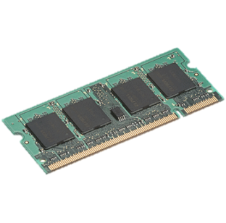
Goal: In-Memory Data Sharing
iter. 1
iter. 2
. . .
Input
query 1
one-time processing
query 2
query 3
Input
. . .
10-100× faster than network/disk, but how to get FT?

Slide 7
Challenge
How to design a distributed memory abstraction that is both fault-tolerant and efficient?

Slide 8
Challenge
Existing storage abstractions have interfaces based on fine-grained updates to mutable state
RAMCloud, databases, distributed mem, Piccolo
Requires replicating data or logs across nodes for fault tolerance
Costly for data-intensive apps
10-100x slower than memory write
Notes:
Say it’s expensive for data-intensive apps in particular
Data-intensive vs transactional -> show spectrum with update granularity and write throughput

Slide 9
Solution: Resilient Distributed Datasets (RDDs)
Restricted form of distributed shared memory
Immutable, partitioned collections of records
Can only be built through coarse-grained deterministic transformations (map, filter, join, …)
Efficient fault recovery using lineage
Log one operation to apply to many elements
Recompute lost partitions on failure
No cost if nothing fails
Notes:
Define RDDs more precisely here!

Slide 10
RDD Recovery
iter. 1
iter. 2
. . .
Input
query 1
one-time processing
query 2
query 3
Input
. . .

Slide 11
Generality of RDDs
Despite their restrictions, RDDs can express surprisingly many parallel algorithms
These naturally apply the same operation to multiple items
Unify many current programming models
Data flow models: MapReduce, Dryad, SQL, …
Specialized models for iterative apps: BSP (Pregel), iterative MapReduce (Haloop), bulk incremental, …
Support new apps that these models don’t
Notes:
Similarity to GFS/HDFS: large blocks, append only.

Slide 12




Spark architecture
Spark Driver (Master)
Cluster Manager
Spark Worker
Cache
Spark Worker
Cache
Spark Worker
Cache
....
Datanode
Datanode
....
Datanode
Block
Block
Block
HDFS

Slide 13
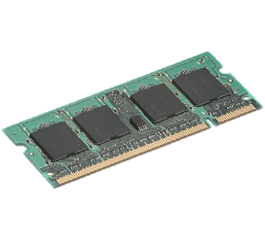

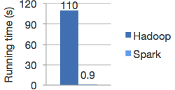
Spark
HDFS read
iter. 1
iter. 2
. . .
Input
Not tied to 2 stage Map Reduce paradigm
Extract a working set
Cache it
Query it repeatedly
Logistic regression in Hadoop and Spark

Slide 14

Spark Programming Model
Driver Program
sc=new SparkContext
rDD=sc.textfile(“hdfs://…”)
rDD.filter(…)
rDD.Cache
rDD.Count
rDD.map
Cluster Manager
SparkContext
Worker Node
Worker Node
Executer
Cache
Executer
Writes
Cache
Task
Task
Task
Task
Datanode
…
Datanode
User (Developer)
HDFS

Slide 15
Spark Programming Model
Driver Program
sc=new SparkContext
rDD=sc.textfile(“hdfs://…”)
rDD.filter(…)
rDD.Cache
rDD.Count
rDD.map
Immutable Data structure
In-memory (explicitly)
Fault Tolerant
Parallel Data Structure
Controlled partitioning to optimize data placement
Can be manipulated using rich set of operators.
RDD
(Resilient Distributed Dataset)
Writes
User (Developer)
Notes:
Resilient Distributed Datasets or RDD are the distributed memory abstractions that lets programmer perform in-memory parallel computations on large clusters. And that too in a highly fault tolerant manner.
This is the main concept around which the whole Spark framework revolves around.
Currently 2 types of RDDs:
Parallelized collections: Created by calling parallelize method on an existing Scala collection. Developer can specify the number of slices to cut the dataset into. Ideally 2-3 slices per CPU.
Hadoop Datasets: These distributed datasets are created from any file stored on HDFS or other storage systems supported by Hadoop (S3, Hbase etc). These are created using SparkContext’s textFile method. Default number of slices in this case is 1 slice per file block.

Slide 16
Outline
Introduction to Scala & functional programming
What is Spark
Resilient Distributed Datasets (RDDs)
Implementation
Demo
Conclusion

Slide 17
About Scala
High-level language for JVM
>> Object-oriented + Functional programming (FP)
Statically typed
>> Comparable in speed to Java
>> no need to write types due to type inference
Interoperates with Java
>> Can use any Java class, inherit from it, etc;
>> Can also call Scala code from Java

Slide 18
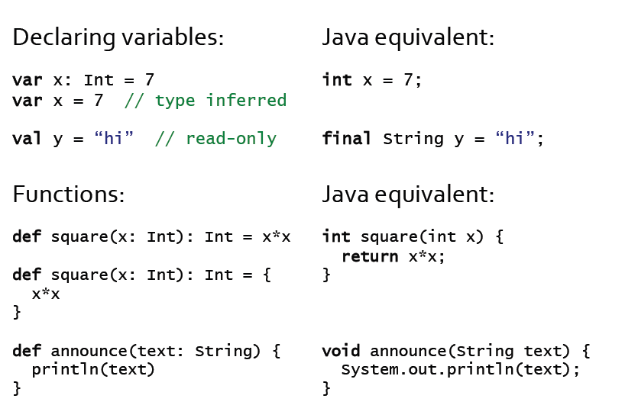

Quick Tour

Slide 19
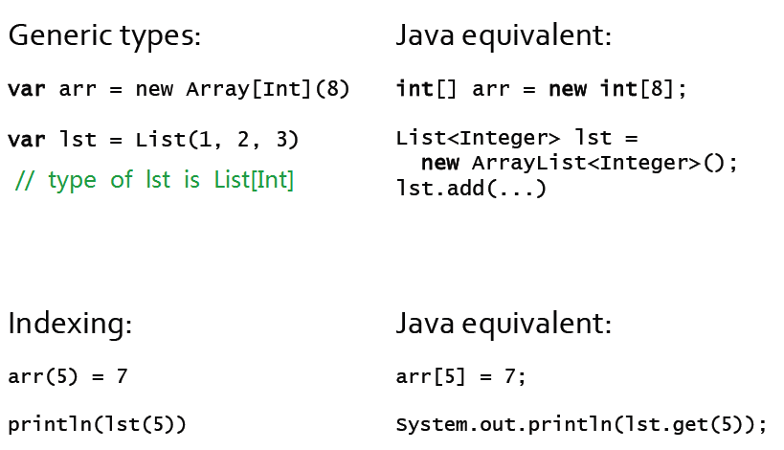
Quick Tour

Slide 20
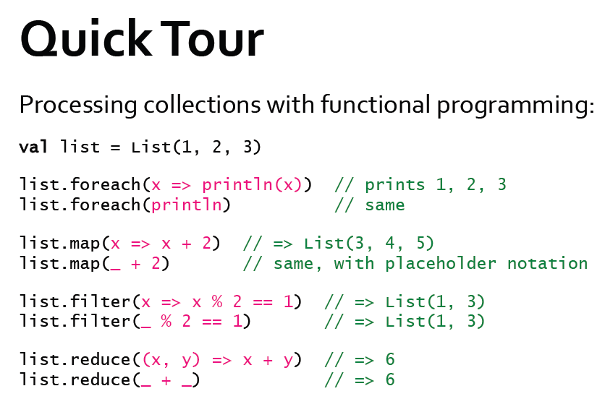

All of these leave the list unchanged (List is Immutable)

Slide 21
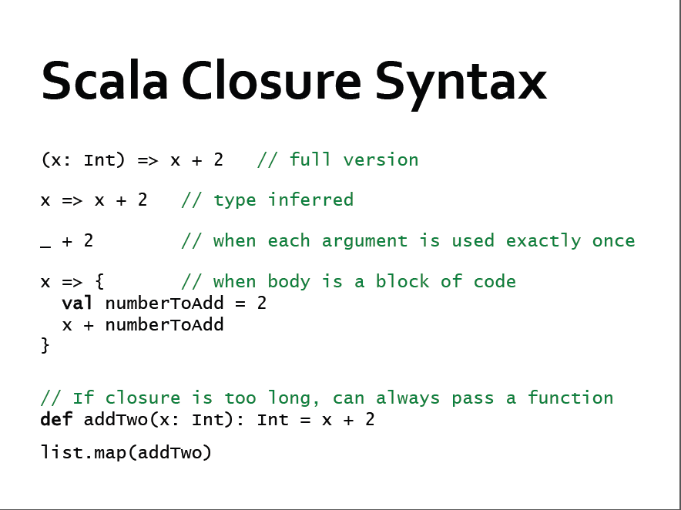


Slide 22
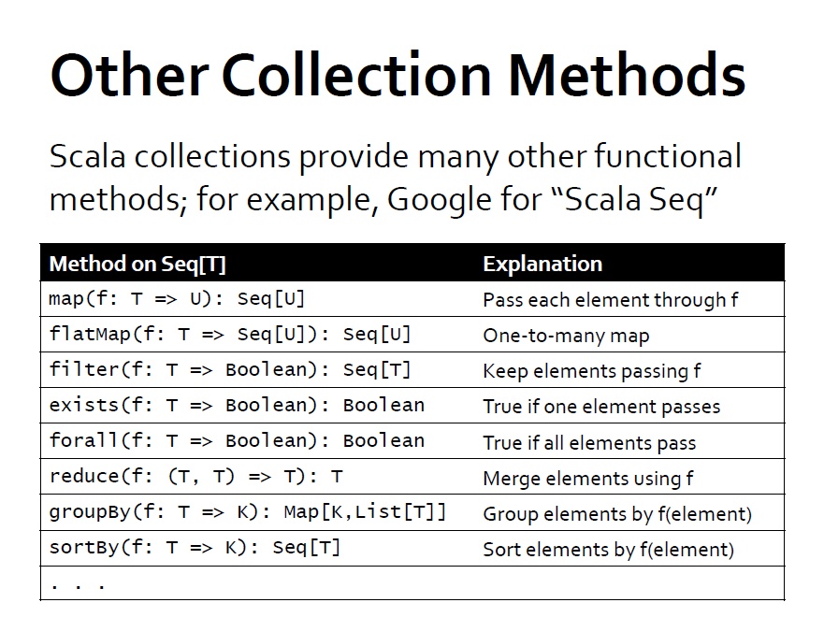

Slide 23
Outline
Introduction to Scala & functional programming
What is Spark
Resilient Distributed Datasets (RDDs)
Implementation
Demo
Conclusion

Slide 24
Spark Overview
Goal: work with distributed collections as you would with local ones
Concept: resilient distributed datasets (RDDs)
>> Immutable collections of objects spread across a cluster
>> Built through parallel transformations (map, filter, etc)
>> Automatically rebuilt on failure
>> Controllable persistence (e.g. caching in RAM) for reuse
>> Shared variables that can be used in parallel operations

Slide 25
Outline
Introduction to Scala & functional programming
What is Spark
Resilient Distributed Datasets (RDDs)
Implementation
Demo
Conclusion

Slide 26
RDD Abstraction
An RDD is a read-only , partitioned collection of records
Can only be created by :
(1) Data in stable storage
(2) Other RDDs (transformation , lineage)
An RDD has enough information about how it was derived from other datasets(its lineage)
Users can control two aspects of RDDs:
1) Persistence (in RAM, reuse)
2) Partitioning (hash, range, [<k, v>])

Slide 27
RDDs in More Detail
An RDD is an immutable, partitioned, logical collection of records
Need not be materialized, but rather contains information to rebuild a dataset from stable storage
Partitioning can be based on a key in each record (using hash or range partitioning)
Built using bulk transformations on other RDDs
Can be cached for future reuse

Slide 28
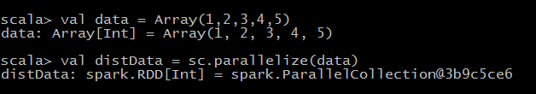
RDD Types: parallelized collections
By calling SparkContext’s parallelize method on an existing Scala collection (a Seq obj)
Once created, the distributed dataset can be operated on in parallel

Slide 29
RDD Types: Hadoop Datasets
Spark supports text files, SequenceFiles, and any other Hadoop inputFormat
val distFiles = sc.textFile(URI)
Other Hadoop inputFormat
val distFile = sc.hadoopRDD(URI)
Local path or hdfs://, s3n://, kfs://

Slide 30
RDD
Programming Interface: Programmer can perform 3 types of operations
Transformations
Create a new dataset from and existing one.
Lazy in nature. They are executed only when some action is performed.
Example :
Map(func)
Filter(func)
Distinct()
Actions
Returns to the driver program a value or exports data to a storage system after performing a computation.
Example:
Count()
Reduce(funct)
Collect
Take()
Persistence
For caching datasets in-memory for future operations.
Option to store on disk or RAM or mixed (Storage Level).
Example:
Persist()
Cache()
Notes:
Transformations: Like map – takes an RDD as an input, passes & process each element to a function, and return a new transformed RDD as an output.
By default, each transformed RDD is recomputed each time you run an action on it. Unless you specify the RDD to be cached in memory. Spark will try to keep the elements around the cluster for faster access.
RDD can be persisted on discs as well.
Caching is the Key tool for iterative algorithms.
Using persist, one can specify the Storage Level for persisting an RDD. Cache is just a short hand for default storage level. Which is MEMORY_ONLY.
MEMORY_ONLY
Store RDD as deserialized Java objects in the JVM. If the RDD does not fit in memory, some partitions will not be cached and will be recomputed on the fly each time they're needed. This is the default level.
MEMORY_AND_DISK
Store RDD as deserialized Java objects in the JVM. If the RDD does not fit in memory, store the partitions that don't fit on disk, and read them from there when they're needed.
MEMORY_ONLY_SER
Store RDD as serialized Java objects (one byte array per partition). This is generally more space-efficient than deserialized objects, especially when using a fast serializer, but more CPU-intensive to read.
MEMORY_AND_DISK_SER
Similar to MEMORY_ONLY_SER, but spill partitions that don't fit in memory to disk instead of recomputing them on the fly each time they're needed.
DISK_ONLY
Store the RDD partitions only on disk.
MEMORY_ONLY_2, MEMORY_AND_DISK_2 etc
Same as the levels above, but replicate each partition on two cluster nodes.
Which Storage level is best:
Few things to consider:
Try to keep in-memory as much as possible
Try not to spill to disc unless your computed datasets are memory expensive
Use replication only if you want fault tolerance

Slide 31
RDD Operations
Transformations
>> create a new dataset from an existing one
Actions
>> Return a value to the driver program
Transformations are lazy, they don’t compute right away. Just remember the transformations applied to datasets(lineage). Only compute when an action require.

Slide 32
Spark Operations
Transformations (define a new RDD) | map filter sample groupByKey reduceByKey sortByKey | flatMap union join cogroup cross mapValues
Actions (return a result to driver program) | collect reduce count save lookupKey

Slide 33
Transformations
Transformations | Meaning
map(func) | Return a new distributed dataset formed by passing each element of the source through a function func
flatMap(func) | Return a new datasets formed by selecting those elements of the source on which func returns true
union(otherDateset) | Return a new dataset that contains the union of the elements in the source dataset and the argument
… | …

Slide 34
Actions
Actions | Meaning
reduce(func) | Aggregate the elements of the dataset using a function func
collect() | Return all the elements of the dataset as an array at the driver program
count() | Return the number of elements in dataset
first() | Return the first element of the dataset
saveAsTextFile(path) ….. | Write the elements of the dataset as text file (or set of text file) in a given dir in the local file system, HDFS or any other Hadoop-supported file system ……

Slide 35
Memory Management
Spark provides three options for persist RDDs:
(1) in-memory storage as deserialized Java Objs
>> fastest, JVM can access RDD natively
(2) in-memory storage as serialized data
>> space limited, choose another efficient representation, lower performance cost
(3) on-disk storage
>> RDD too large to keep in memory, and costly to recompute

Slide 36

Example: Log Mining
Load error messages from a log into memory, then interactively search for various patterns
Base RDD
Cache 1
lines = spark.textFile(“hdfs://...”)
errors = lines.filter(_.startsWith(“ERROR”))
messages = errors.map(_.split(‘\t’)(2))
cachedMsgs = messages.cache()
Transformed RDD
Worker
results
tasks
Block 1
Driver
Cached RDD
Parallel operation
cachedMsgs.filter(_.contains(“foo”)).count
cachedMsgs.filter(_.contains(“bar”)).count
Cache 2
Worker
. . .
Cache 3
Result: full-text search of Wikipedia in <1 sec (vs 20 sec for on-disk data)
Worker
Block 2
Block 3

Slide 37
RDD Fault Tolerance
RDDs maintain lineage information that can be used to reconstruct lost partitions
Ex:
cachedMsgs = textFile(...).filter(_.contains(“error”))
.map(_.split(‘\t’)(2))
.cache()
HdfsRDD
path: hdfs://…
FilteredRDD
func: contains(...)
MappedRDD
func: split(…)
CachedRDD

Slide 38
Fault Recovery
RDDs track the graph of transformations that built them (their lineage) to rebuild lost data
E.g.:
messages = textFile(...).filter(_.contains(“error”))
.map(_.split(‘\t’)(2))
HadoopRDD
FilteredRDD
MappedRDD
HadoopRDD
path = hdfs://…
FilteredRDD
func = _.contains(...)
MappedRDD
func = _.split(…)

Slide 39
Benefits of RDD Model
Consistency is easy due to immutability
Inexpensive fault tolerance (log lineage rather than replicating/checkpointing data)
Locality-aware scheduling of tasks on partitions
Despite being restricted, model seems applicable to a broad variety of applications

Slide 40
RDDs vs Distributed Shared Memory
Concern | RDDs | Distr. Shared Mem.
Reads | Fine-grained | Fine-grained
Writes | Bulk transformations | Fine-grained
Consistency | Trivial (immutable) | Up to app / runtime
Fault recovery | Fine-grained and low-overhead using lineage | Requires checkpoints and program rollback
Straggler mitigation | Possible using speculative execution | Difficult
Work placement | Automatic based on data locality | Up to app (but runtime aims for transparency)

Slide 41
Representing RDDs
Challenge: choosing a representation for RDDs that can track lineage across transformations
Each RDD include:
1) A set of partitions(atomic pieces of datasets)
2) A set of dependencies on parent RDDs
3) A function for computing the dataset based
its parents
4) Metadata about its partitioning scheme
5) Data placement

Slide 42
Interface used to represent RDDs
Operation | Meaning
partitons() | Return s list of partition objects
preferredLocations(p) | List nodes where partition p can be accessed faster due to data locality
dependencies() | Return a list of dependencies
iterator(p, parenetIters) | Compute the elements of partition p given iterators for its parent partitions
partitioner() | Return metadata specifying whether the RDD is hash/range partitioned

Slide 43
Internals of the RDD Interface
List of partitions
Set of dependencies on parent RDDs
Function to compute a partition, given parents
Optional partitioning info for k/v RDDs (Partitioner)
RDD
Partition 1
Partition 2
Partition 3
One-to-one aka Narrow dependency and Shuffle dependency. In Narrow dependency, each partition from parent RDD is mapped to partition of new RDD.
In case of shuffle (wide) dependency, a shuffle of data is required between partitions.
This captures all current Spark operations!

Slide 44
Example: Hadoop RDD
Partitions = 1 per HDFS block
Dependencies = None
compute(partition) = read corresponding HDFS block
Partitioner = None
> rdd = spark.hadoopFile(“hdfs://click_logs/”)
This captures all current Spark operations!

Slide 45
Example: Filtered RDD
Partitions = parent partitions
Dependencies = a single parent
compute(partition) = call parent.compute(partition) and filter
Partitioner = parent partitioner
> filtered = rdd.filter(lambda x: x contains “ERROR”)
This captures all current Spark operations!

Slide 46
Example: Joined RDD
Partitions = number chosen by user or heuristics
Dependencies = ShuffleDependency on two or more parents
compute(partition) = read and join data from all parents
Partitioner = HashPartitioner(# partitions)
This captures all current Spark operations!

Slide 47
A More Complex DAG
Hadoop RDD
Filtered RDD
.count()
Partition 1
Partition 1
Joined RDD
Filtered RDD
Partition 2
Partition 2
Partition 1
Partition 1
Partition 2
Partition 2
JDBC RDD
Mapped RDD
Partition 3
Partition 3
Partition 1
Partition 1
Partition 2
Partition 2

Slide 48
A More Complex DAG
Shuffle Write
Shuffle Read
Stage 1
Task 1
Stage 3
Task 2
Task 1
Task 2
Stage 2
Task 3
Task 1
Task 2

Slide 49
Narrow and Wide Transformations
FilteredRDD
JoinedRDD
Parent
RDD
Parent 1
Partition 1
Partition 1
Partition 1
RDD
Partition 2
Partition 2
Partition 2
Partition 1
Partition 3
Partition 3
Partition 2
Parent 2
Partition 3
Partition 1
Partition 2

Slide 50
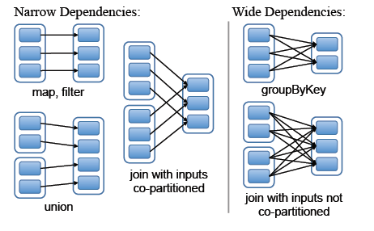
RDD Dependencies
Each box is an RDD, with partitions shown as shaded rectangles

Slide 51
Outline
Introduction to Scala & functional programming
What is Spark
Resilient Distributed Datasets (RDDs)
Implementation
Demo
Conclusion

Slide 52

Let’s look under the hood

Slide 53
How Spark works
RDD: Parallel collection with partitions
User application create RDDs, transform them, and run actions.
This results in a DAG (Directed Acyclic Graph) of operators.
DAG is compiled into stages
Each stage is executed as a series of Task (one Task for each Partition).

Slide 54
Example
sc.textFile(“/wiki/pagecounts”)
RDD[String]
textFile

Slide 55
Example
sc.textFile(“/wiki/pagecounts”)
.map(line => line.split(“\t”))
RDD[String]
RDD[List[String]]
textFile
map

Slide 56
Example
sc.textFile(“/wiki/pagecounts”)
.map(line => line.split(“\t”))
.map(R => (R[0], int(R[1])))
RDD[String]
RDD[List[String]]
RDD[(String, Int)]
textFile
map
map

Slide 57
Example
sc.textFile(“/wiki/pagecounts”)
.map(line => line.split(“\t”))
.map(R => (R[0], int(R[1])))
.reduceByKey(_+_)
RDD[String]
RDD[List[String]]
RDD[(String, Int)]
RDD[(String, Int)]
reduceByKey
textFile
map
map

Slide 58
Example
sc.textFile(“/wiki/pagecounts”)
.map(line => line.split(“\t”))
.map(R => (R[0], int(R[1])))
.reduceByKey(_+_, 3)
.collect()
RDD[String]
RDD[List[String]]
RDD[(String, Int)]
RDD[(String, Int)]
Array[(String, Int)]
collect
reduceByKey

Slide 59
Execution Plan
Stage 1
Stage 2
collect
reduceByKey
textFile
map
map
Stages are sequences of RDDs, that don’t have a Shuffle in between

Slide 60
Execution Plan
Stage 1
Stage 2
collect
reduceByKey
textFile
map
map
Read HDFS split
Apply both the maps
Start Partial reduce
Write shuffle data
Read shuffle data
Final reduce
Send result to driver program
Stage 1
Stage 2

Slide 61
Stage Execution
Task 1
Task 2
Task 2
Task 2
Create a task for each Partition in the new RDD
Serialize the Task
Schedule and ship Tasks to Slaves
And all this happens internally (you need to do anything)

Slide 62
Spark Executor (Slaves)
Fetch Input
Fetch Input
Fetch Input
Core 1
Execute Task
Execute Task
Execute Task
Write Output
Write Output
Write Output
Fetch Input
Fetch Input
Core 2
Execute Task
Execute Task
Write Output
Write Output
Fetch Input
Fetch Input
Core 3
Execute Task
Execute Task
Write Output
Write Output

Slide 63
Summary of Components
Task : The fundamental unit of execution in Spark
Stage : Set of Tasks that run parallel
DAG : Logical Graph of RDD operations
RDD : Parallel dataset with partitions

Slide 64
Beyond RDDs
So far we’ve seen that RDD operations can use variables from outside their scope
By default, each task gets a read-only copy of each variable (no sharing)
Good place to enable other sharing patterns!
Broadcast variables
Accumulators

Slide 65
Shared Variables
Normally when functions are executed on a remote node it works on immutable copies
However, Sparks does provide two types of shared variables for two usages:
Broadcast variables
Accumulators

Slide 66
Broadcast Variables
Broadcast variables allow the programmer to keep a read-only variable cached on each machine rather than shipping a copy of it with tasks.
scala> val broadcastVar = sc.broadcast(Array(1, 2, 3))
broadcastVar: org.apache.spark.broadcast.Broadcast[Array[Int]] = Broadcast(0)
scala> broadcastVar.value
res0: Array[Int] = Array(1, 2, 3)

Slide 67
Accumulators
Accumulators are variables that are only “added” to through an associative operation and can therefore be efficiently supported in parallel
Spark natively supports accumulators of numeric types, and programmers can add support for new types
Note: not yet supported on Python
scala> val accum = sc.accumulator(0, "My Accumulator")
accum: spark.Accumulator[Int] = 0
scala> sc.parallelize(Array(1, 2, 3, 4)).foreach(x => accum += x)
scala> accum.value
res7: Int = 10

Slide 68
Accumulators
object VectorAccumulatorParam extends AccumulatorParam[Vector] {
def zero(initialValue: Vector): Vector = {
Vector.zeros(initialValue.size)
}
def addInPlace(v1: Vector, v2: Vector): Vector = {
v1 += v2
}
}
// Then, create an Accumulator of this type:
val vecAccum = sc.accumulator(new Vector(...))(VectorAccumulatorParam)

Slide 69
Example: Collaborative Filtering
Goal: predict users’ movie ratings based on past ratings of other movies
Movies
1 ? ? 4 5 ? 3
? ? 3 5 ? ? 3
5 ? 5 ? ? ? 1
4 ? ? ? ? 2 ?
R =
Users

Slide 70
Model and Algorithm
Model R as product of user and movie feature matrices A and B of size U×K and M×K
R
A
B^{T}
=
Alternating Least Squares (ALS)
Start with random A & B
Optimize user vectors (A) based on movies
Optimize movie vectors (B) based on users
Repeat until converged

Slide 71
Serial ALS
var R = readRatingsMatrix(...)
var A = // array of U random vectors
var B = // array of M random vectors
for (i <- 1 to ITERATIONS) {
A = (0 until U).map(i => updateUser(i, B, R))
B = (0 until M).map(i => updateMovie(i, A, R))
}
Range objects

Slide 72
Naïve Spark ALS
var R = readRatingsMatrix(...)
var A = // array of U random vectors
var B = // array of M random vectors
for (i <- 1 to ITERATIONS) {
A = spark.parallelize(0 until U, numSlices)
.map(i => updateUser(i, B, R))
.collect()
B = spark.parallelize(0 until M, numSlices)
.map(i => updateMovie(i, A, R))
.collect()
}
Problem: R re-sent to all nodes in each iteration

Slide 73
Efficient Spark ALS
Solution: mark R as broadcast variable
var R = spark.broadcast(readRatingsMatrix(...))
var A = // array of U random vectors
var B = // array of M random vectors
for (i <- 1 to ITERATIONS) {
A = spark.parallelize(0 until U, numSlices)
.map(i => updateUser(i, B, R.value))
.collect()
B = spark.parallelize(0 until M, numSlices)
.map(i => updateMovie(i, A, R.value))
.collect()
}
Result: 3× performance improvement

Slide 74
Scaling Up Broadcast
Initial version (HDFS)
Cornet P2P broadcast
[Chowdhury et al, SIGCOMM 2011]

Slide 75
Accumulators
Apart from broadcast, another common sharing pattern is aggregation
Add up multiple statistics about data
Count various events for debugging
Spark’s reduce operation does aggregation, but accumulators are another nice way to express it

Slide 76
Usage
val badRecords = sc.accumulator(0) val badBytes = sc.accumulator(0.0)
records.filter(r => { if (isBad(r)) { badRecords += 1 badBytes += r.size false } else { true } }).save(...)
printf(“Total bad records: %d, avg size: %f\n”, badRecords.value, badBytes.value / badRecords.value)
Accumulator[Int]
Accumulator[Double]

Slide 77
Working With Spark

Slide 78
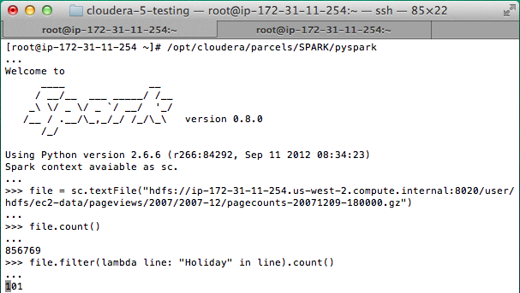
Using the Shell
Launching:
Modes:
spark-shell
pyspark (IPYTHON=1)
MASTER=local ./spark-shell # local, 1 thread MASTER=local[2] ./spark-shell # local, 2 threads MASTER=spark://host:port ./spark-shell # cluster
Main entry point to Spark functionality
Available in shell as variable sc

Slide 79
Creating RDDs
# Turn a Python collection into an RDD
sc.parallelize([1, 2, 3])
# Load text file from local FS, HDFS, or S3
sc.textFile(“file.txt”)
sc.textFile(“directory/*.txt”)
sc.textFile(“hdfs://namenode:9000/path/file”)
# Use existing Hadoop InputFormat (Java/Scala only)
sc.hadoopFile(keyClass, valClass, inputFmt, conf)

Slide 80
Basic Transformations
nums = sc.parallelize([1, 2, 3])
# Pass each element through a function
squares = nums.map(lambda x: x*x) // {1, 4, 9}
# Keep elements passing a predicate
even = squares.filter(lambda x: x % 2 == 0) // {4}
# Map each element to zero or more others
nums.flatMap(lambda x: => range(x))
# => {0, 0, 1, 0, 1, 2}
Range object (sequence of numbers 0, 1, …, x-1)
Notes:
All lazy

Slide 81
Basic Transformations/Actions: Scala
scala>val number = List(1, 2, 3)
number: List[Int] = List(1, 2, 3)
scala> squares = number.map(x=>x*x)
scala> val squares = number.map(x=>x*x)
squares: List[Int] = List(1, 4, 9)
scala> val even = squares.filter(x=>x%2==0)
even: List[Int] = List(4)
scala>val range = even.flatMap(x => Range (1,x,1))
range: List[Int] = List(1, 2, 3)
scala> val range = even.flatMap(x => Range (1,x,2))
range: List[Int] = List(1, 3)
scala> val rangeRDD = sc.parallelize(range)
scala> val counter = rangeRDD.collect()
Array[Int] = Array(1, 3)
https://www.safaribooksonline.com/library/view/learning-spark/9781449359034/ch04.html

Slide 82
Basic Actions
nums = sc.parallelize([1, 2, 3])
# Retrieve RDD contents as a local collection
nums.collect() # => [1, 2, 3]
# Return first K elements
nums.take(2) # => [1, 2]
# Count number of elements
nums.count() # => 3
# Merge elements with an associative function
nums.reduce(lambda x, y: x + y) # => 6
# Write elements to a text file
nums.saveAsTextFile(“hdfs://file.txt”)
Notes:
Launch computations

Slide 83
Working with Key-Value Pairs
Spark’s “distributed reduce” transformations operate on RDDs of key-value pairs
Python: pair = (‘a’, ‘b’) pair[0] # => a pair[1] # => b
Scala: val pair = (‘a’, ‘b’) pair._1 // => a pair._2 // => b
Java: Tuple2 pair = new Tuple2(‘a’,’b’); pair._1 // => a pair._2 // => b

Slide 84
Some Key-Value Operations
pets = sc.parallelize( [(“cat”, 1), (“dog”, 1), (“cat”, 2)])
pets.reduceByKey(lambda x, y: x + y) # => {(cat, 3), (dog, 1)}
pets.groupByKey() # => {(cat, [1, 2]), (dog, [1])}
pets.sortByKey() # => {(cat, 1), (cat, 2), (dog, 1)}
reduceByKey also automatically implements combiners on the map side

Slide 85
Example: Word Count
Python
Scala
lines = sc.textFile(“hamlet.txt”)
counts = lines.flatMap(lambda line: line.split(“ ”)).map(lambda word => (word, 1)).reduceByKey(lambda x, y: x + y)
lines = sc.textFile(“hamlet.txt”)
counts = lines.flatMap(line => line.split(“ ”) ).map(word => (word, 1))
.reduceByKey(_+_)
“to” “be” “or”
(to, 1) (be, 1) (or, 1)
(be, 2) (not, 1)
“to be or”
“not” “to” “be”
(not, 1) (to, 1) (be, 1)
(or, 1)
(to, 2)
“not to be”

Slide 86
Other Key-Value Operations
visits = sc.parallelize([ (“index.html”, “1.2.3.4”), (“about.html”, “3.4.5.6”), (“index.html”, “1.3.3.1”) ])
pageNames = sc.parallelize([ (“index.html”, “Home”), (“about.html”, “About”) ])
visits.join(pageNames) # (“index.html”, (“1.2.3.4”, “Home”)) # (“index.html”, (“1.3.3.1”, “Home”)) # (“about.html”, (“3.4.5.6”, “About”))
visits.cogroup(pageNames) # (“index.html”, ([“1.2.3.4”, “1.3.3.1”], [“Home”])) # (“about.html”, ([“3.4.5.6”], [“About”]))

Slide 87
Setting the Level of Parallelism
All the pair RDD operations take an optional second parameter for number of tasks
words.reduceByKey(lambda x, y: x + y, 5)
words.groupByKey(5)
visits.join(pageViews, 5)

Slide 88
Example Application: PageRank
Notes:
To Skip to the next section, go to slide 51

Slide 89
Example: PageRank
Good example of a more complex algorithm
Multiple stages of map & reduce
Benefits from Spark’s in-memory caching
Multiple iterations over the same data

Slide 90
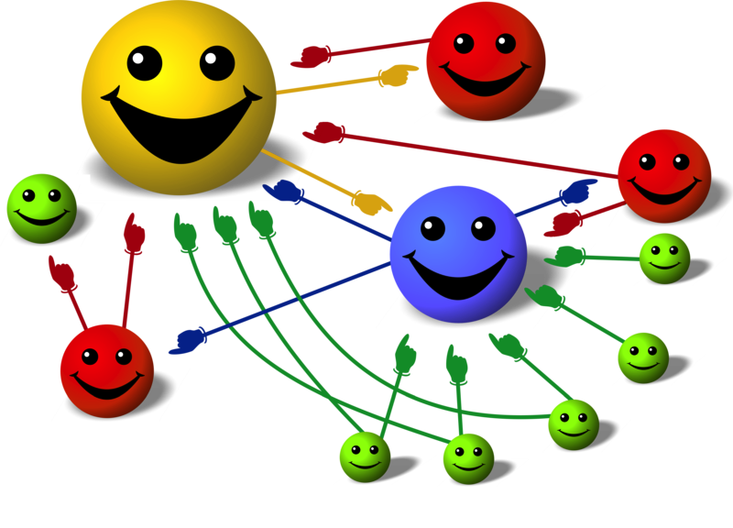
Basic Idea
Give pages ranks (scores) based on links to them
Links from many pages ➔ high rank
Link from a high-rank page ➔ high rank
Image: en.wikipedia.org/wiki/File:PageRank-hi-res-2.png

Slide 91
Algorithm
Start each page at a rank of 1
On each iteration, have page p contribute rank_{p} / |neighbors_{p}| to its neighbors
Set each page’s rank to 0.15 + 0.85 × contribs
1.0
1.0
1.0
1.0

Slide 92
Algorithm
Start each page at a rank of 1
On each iteration, have page p contribute rank_{p} / |neighbors_{p}| to its neighbors
Set each page’s rank to 0.15 + 0.85 × contribs
1.0
1
0.5
1
1.0
0.5
1.0
0.5
0.5
1.0

Slide 93
Algorithm
Start each page at a rank of 1
On each iteration, have page p contribute rank_{p} / |neighbors_{p}| to its neighbors
Set each page’s rank to 0.15 + 0.85 × contribs
1.85
0.58
1.0
0.58

Slide 94
Algorithm
Start each page at a rank of 1
On each iteration, have page p contribute rank_{p} / |neighbors_{p}| to its neighbors
Set each page’s rank to 0.15 + 0.85 × contribs
1.85
0.58
0.5
1.85
0.58
0.29
1.0
0.5
0.29
0.58

Slide 95
Algorithm
Start each page at a rank of 1
On each iteration, have page p contribute rank_{p} / |neighbors_{p}| to its neighbors
Set each page’s rank to 0.15 + 0.85 × contribs
1.31
0.39
. . .
1.72
0.58

Slide 96
Algorithm
Start each page at a rank of 1
On each iteration, have page p contribute rank_{p} / |neighbors_{p}| to its neighbors
Set each page’s rank to 0.15 + 0.85 × contribs
Final state:
1.44
1
0.46
4
2
1.37
3
0.73

Slide 97
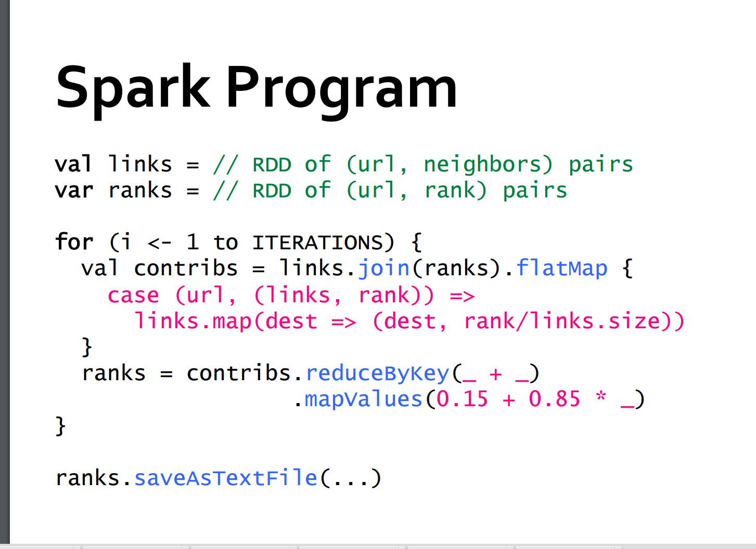

Slide 98
Page Rank
PageRank is an iterative algorithm that performs many joins, so it is a good use case for RDD partitioning.
The algorithm maintains two datasets: one of (pageID, linkList) elements containing the list of neighbors of each page, and one of (pageID, rank) elements containing the current rank for each page. It proceeds as follows:
Initialize each page’s rank to 1.0.
On each iteration, have page p send a contribution of rank(p)/numNeighbors(p) to its neighbors (the pages it has links to).
Set each page’s rank to 0.15 + 0.85 * contributionsReceived.
The last two steps repeat for several iterations, during which the algorithm will converge to the correct PageRank value for each page. In practice, it’s typical to run about 10 iterations.

Slide 99
Example 4-25 gives the code to implement PageRank in Spark.
Example 4-25. Scala PageRank
Source: https://www.safaribooksonline.com/library/view/learning-spark/9781449359034/ch04.html
// Assume that our neighbor list was saved as a Spark objectFile
val links = sc.objectFile[(String, Seq[String])]("links")
.partitionBy(new HashPartitioner(100))
.persist()
// Initialize each page's rank to 1.0; since we use mapValues, the resulting RDD
// will have the same partitioner as links
var ranks = links.mapValues(v => 1.0)
// Run 10 iterations of PageRank
for (i <- 0 until 10) {
val contributions = links.join(ranks).flatMap {
case (pageId, (links, rank)) =>
links.map(dest => (dest, rank / links.size))
}
ranks = contributions.reduceByKey((x, y) => x + y).mapValues(v => 0.15 + 0.85*v)
}
// Write out the final ranks
ranks.saveAsTextFile("ranks")

Slide 100
Page Rank
That’s it! The algorithm starts with a ranks RDD initialized at 1.0 for each element, and keeps updating the ranks variable on each iteration.
The body of PageRank is pretty simple to express in Spark: it first does a join() between the current ranks RDD and the static links one, in order to obtain the link list and rank for each page ID together, then uses this in a flatMap to create “contribution” values to send to each of the page’s neighbors.
We then add up these values by page ID (i.e., by the page receiving the contribution) and set that page’s rank to 0.15 + 0.85 * contributionsReceived.
Although the code itself is simple, the example does several things to ensure that the RDDs are partitioned in an efficient way, and to minimize communication:
Notice that the links RDD is joined against ranks on each iteration. Since links is a static dataset, we partition it at the start with partitionBy(), so that it does not need to be shuffled across the network. In practice, the links RDD is also likely to be much larger in terms of bytes than ranks, since it contains a list of neighbors for each page ID instead of just a Double, so this optimization saves considerable network traffic over a simple implementation of PageRank (e.g., in plain MapReduce).
For the same reason, we call persist() on links to keep it in RAM across iterations.
When we first create ranks, we use mapValues() instead of map() to preserve the partitioning of the parent RDD (links), so that our first join against it is cheap.
In the loop body, we follow our reduceByKey() with mapValues(); because the result of reduceByKey() is already hash-partitioned, this will make it more efficient to join the mapped result against links on the next iteration.

Slide 101
PageRank Performance
Notes:
54 GB Wikipedia dataset

Slide 102
Other Iterative Algorithms
Time per Iteration (s)
Notes:
100 GB datasets

Slide 103
Spark Examples
Let’s walk through http://spark.apache.org/examples.html
Other examples are on
Basic Sample =>https://github.com/apache/spark/tree/master/examples/src/main/scala/org/apache/spark/examples
Streaming Samples => https://github.com/apache/spark/tree/master/examples/src/main/scala/org/apache/spark/examples/streaming

